Slide 1
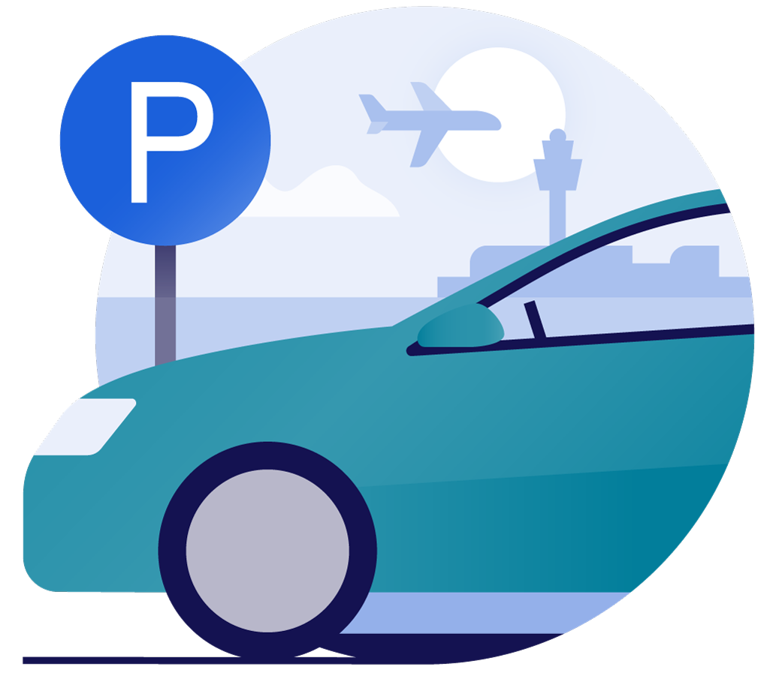
Rakna
Guide

Slide 2
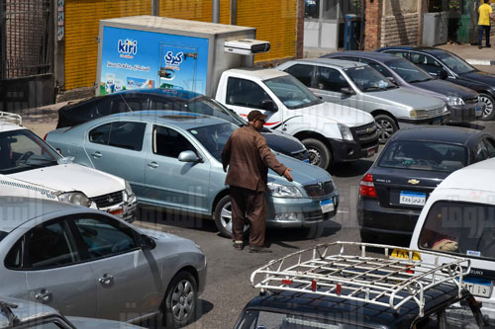
The Problem

Slide 3
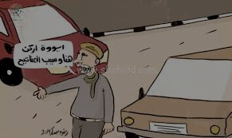
The Problem

Slide 4
Cairo City
Cairo has more than 19.5 million inhabitants.
There is more than one fifth of Egypt's population in Cairo.
Egypt has more than 8 million vehicles.
Cairo governorate ranked first with 4 million vehicles licensed.
Notes:
القاهرة هي عاصمة مصر ويبلغ عدد سكانها أكثر من 19 مليون نسمة ، وتستضيف أكثر من خمس سكان مصر. كما انها مساهم مهم في الاقتصاد المصري من حيث الناتج المحلي الإجمالي والوظائف.
منطقة العاصمة الكبرى القاهرة

Slide 5
Solution Description
Rakna is a peer to peer parking system
Garage
Rakna
Car

Slide 6
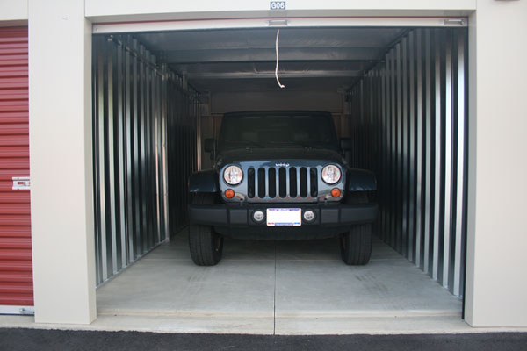
Customers
All vehicles can use our system to have a secure garage
Owners of garages who want to invest for a period of time

Slide 7
Prototype Diagram
User Smart phone
Rakna registered garages
Route to picked garage
Payment
Garage security system

Slide 8
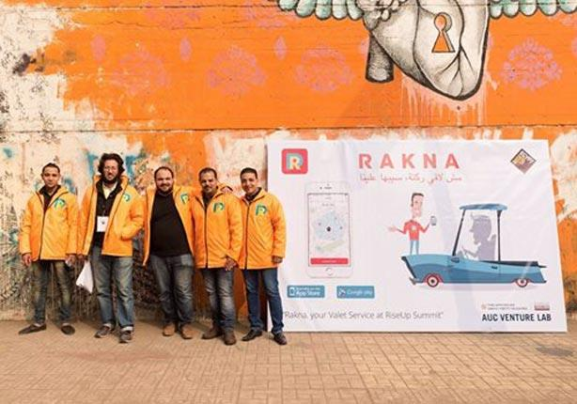


Competitors

